Slide 1
Building .NET Desktop Applications with .NET Core and Windows 10

Slide 2
Agenda
Upgrading .NET Desktop Apps
Tips and tricks for updating from .NET Framework to .NET Core
Roadmap
Q&A

Slide 3
Upgrading .NET Desktop Apps

Slide 4
Platform Options
Windows Forms
Windows Presentation Foundation
Universal Windows Platform (UWP)

Slide 5

Platform Options
Windows Forms
Windows Presentation Foundation
Universal Windows Platform (UWP)

Slide 6
Platform Options
Windows Forms
Windows Presentation Foundation
Universal Windows Platform (UWP)

Slide 7
UI Framework Options
Windows Presentation Foundation: https://github.com/dotnet/wpf
Windows Forms: https://github.com/dotnet/winforms
Windows 10 XAML: https://github.com/Microsoft/microsoft-ui-xaml

Slide 8
Upgrading .NET Desktop Apps
What does ‘Upgrading’ even mean?

Slide 9
Upgrades for Windows Desktop Development
Agility to innovate at a developer pace
With .NET Core 3.0, you are no longer bound to machine-wide .NET Framework dependencies
Modern runtime, BCL and language features
New development is happening in .NET Core, including runtime optimizations and new language features
Easy access to platform and device APIs
Seamless application deployment, updates, and optimized for DevOps
Modern and accessible UI and input
E.g. Bluetooth, Camera, Location, Notifications, etc…
MSIX packaging supports automatic, incremental, behind-the-scenes application updates.
.NET Core supports CLI acquisition and updates for easy DevOps supports
Add in Windows 10 XAML where it makes sense for your applications with XAML Islands

Slide 10
Why Upgrade Windows Desktop Apps?
Agility to innovate at a developer pace
With .NET Core 3.0, you are no longer bound to machine-wide .NET Framework dependencies
Modern runtime, BCL and language features
New development is happening in .NET Core, including runtime optimizations and new language features
Easy access to platform and device APIs
Seamless application deployment, updates, and optimized for DevOps
Modern and accessible UI and input
E.g. Bluetooth, Camera, Location, Notifications, etc…
MSIX packaging supports automatic, incremental, behind-the-scenes application updates.
.NET Core supports CLI acquisition and updates for easy DevOps supports
Add in Windows 10 XAML where it makes sense for your applications with XAML Islands

Slide 11
Modern runtime, BCL and language features
Access to platform and device APIs
Modern and accessible UI and input
Seamless application deployment, updates, and optimized for DevOps
Agility to innovate at a developer pace
Notes:
Demo: PieSample

Slide 12
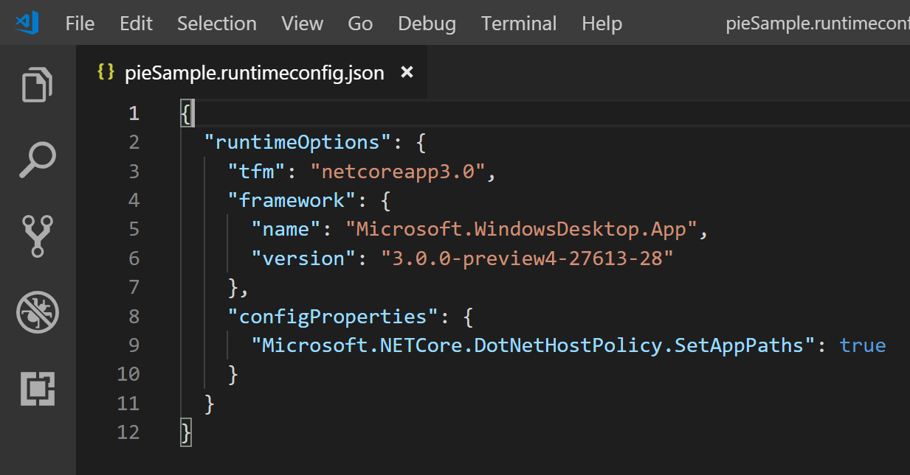
Demo Recap:
For testing purposes, you can run existing .NET Framework applications against the .NET Core Runtime

Slide 13
Runtime performance impact
Runtime optimizations will be most noticed in:
File I/O
Networking
Database operations
For .NET Core 3.0, you may not see performance benefits in:
UI rendering performance
Startup time
Notes:
When compared to .NET Framework

Slide 14


Modern Runtime: Case Study
"Our product is not a maintenance product. With .NET Core, we can update to the latest runtime and reap the benefits that Microsoft consistently delivers with each new .NET Core release.“
"Default interface implementation coming to .NET Core is one example of a new language feature that will help us improve our software development practices."
Notes:
"As far as ease of porting, we've seen relatively little pain with our efforts... There are some really nice workflows you can do such as top-down proof-of-concept and bottom-up to get everything working right."

Slide 15
Access to platform and device APIs
Modern runtime, BCL and language features
Modern and accessible UI and input
Seamless application deployment, updates, and optimized for DevOps
Agility to innovate at a developer pace

Slide 16
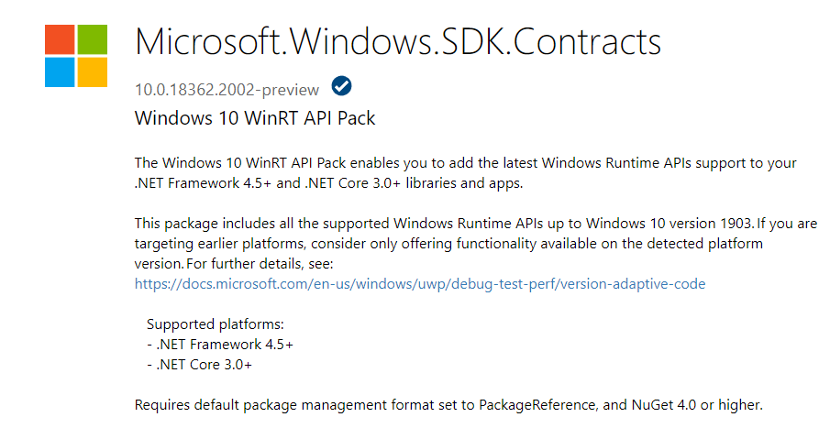
https://www.nuget.org/packages/Microsoft.Windows.SDK.Contracts

Slide 17

Platform and Device APIs – Case Study
WPF is used for device testing in manufacturing
New hardware line has no physical ports – only connects to a remote device via Bluetooth LE
Any components they use must undergo regulatory scrutiny
Unable to use pure-UWP due to driver dependency requirements and wanted to leverage their existing WPF assets
“.NET Core 3.0 allowed us to simplify our code and take advantage of modern Windows 10 APIs. Leveraging the Windows 10’s Bluetooth stack allowed us to drastically speed up development.“

Slide 18
Modern and accessible UI and input
Modern runtime, BCL and language features
Access to platform and device APIs
Seamless application deployment, updates, and optimized for DevOps
Agility to innovate at a developer pace

Slide 19
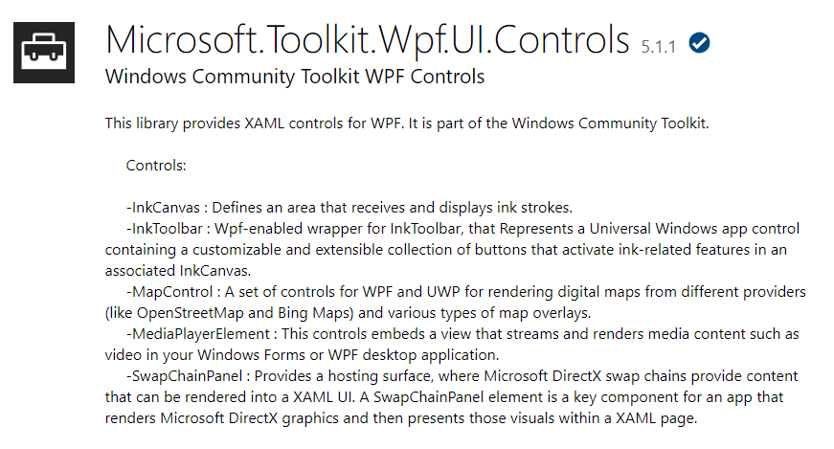
https://www.nuget.org/packages/Microsoft.Toolkit.Wpf.Ui.Controls

Slide 20
XAML Islands Components Recap
Windows shipped
App developer code
UWP Custom Controls
WinUI 2.x
WPF app
WinForms app
C++ Win32 app
WPF Control Wrappers
WinForms Control Wrappers
WPF XAML Host
WinForms XAML Host
App code
HWnd
OS code
Xaml Framework
Xaml Hosting API
Inbox Xaml Controls
Composition, Animation, Input
Windows 10 Subsystems: DirectX, Kernel, drivers, device access, …
1507 | 1511 | 1607 | 1703 | 1709 | 1803 | 1809 | 1903

Slide 21
XAML Islands Components Future
Windows shipped
App developer code
WinUI 3.0
Xaml Controls
Xaml Framework & Xaml Host
UWP Custom Controls
Composition, Animation, Input
HWnd
WPF app
WinForms app
C++ Win32 app
WPF Control Wrappers
WinForms Control Wrappers
WPF XAML Host
WinForms XAML Host
App code
OS code
Windows 10 Subsystems: Presentation platform, DirectX, Kernel, drivers, device access, …
1507 | 1511 | 1607 | 1703 | 1709 | 1803 | 1809 | 1903

Slide 22
Seamless application deployment, updates, and optimized for DevOps
Modern runtime, BCL and language features
Access to platform and device APIs
Modern and accessible UI and input
Agility to innovate at a developer pace

Slide 23
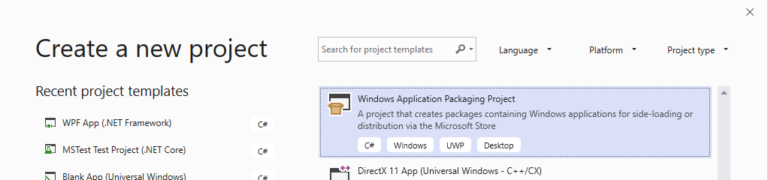
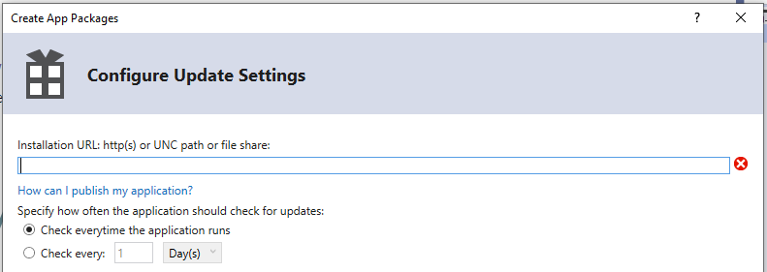
Use the Windows Application Packaging Project in Visual Studio
When creating your app package, configure app deployment and update settings

Slide 24

Enterprise deployments
Citrix is updating their WPF application with Windows 10 and MSIX package to enable:
Package specific features, such as Push Notifications as well as other Windows 10 Platform APIs
Store deployments and support on Windows 10 S Devices
The ability to enable customers to deploy the app seamlessly for their Enterprise

Slide 25
MSIX Core
Install your MSIX apps on all supported Windows versions
MSIX Core Library allows to install, query, update and remove MSIX
https://github.com/Microsoft/msix-packaging
Notes:
Rido
This is also used for Windows to enable MSIX on more Windows supported platforms. It brings an MSI like installation to more Windows platforms.
The developer release will enable a library to be used in your “setup.exe” to Install, update or remove MSIX for the user. For enterprises we will have a one time redistributable that can be deployed to your clients to enable MSIX as a support installer type.
MSIX Core leverage the blockmap, integrity, and structure of the manifest to enable developers to use one package across any Windows operating system. MSIX core is built on our open source cross platform SDK enabling you to adopt MSIX for all your packaging and deployment needs.

Slide 26
Agility to innovate at a developer pace
Modern runtime, BCL and language features
Access to platform and device APIs
Modern and accessible UI and input
Seamless application deployment, updates, and optimized for DevOps

Slide 27
Upgrading Windows Desktop Apps – How?
Agility to innovate at a developer pace
Deploy .NET with your application for guaranteed compatibility and deployment flexibility
Modern runtime, BCL and language features
Upgrade your application from .NET Framework to .NET Core
Easy access to platform and device APIs
Seamless application deployment, updates, and optimized for DevOps
Modern and accessible UI and input
Add a reference to the Microsoft.Windows.SDK.Contracts NuGet package
Use the Windows Application Packaging Project to create an .MSIX package with .appinstaller technology
Use toolkit provided controls, or build your own and host them with the XAML Host Control
Use Azure DevOps + .NET Core SDK for easy client DevOps

Slide 28
Tips and tricks for migrating from .NET Framework to .NET Core

Slide 29

Porting
What can possibly go wrong?

Slide 30
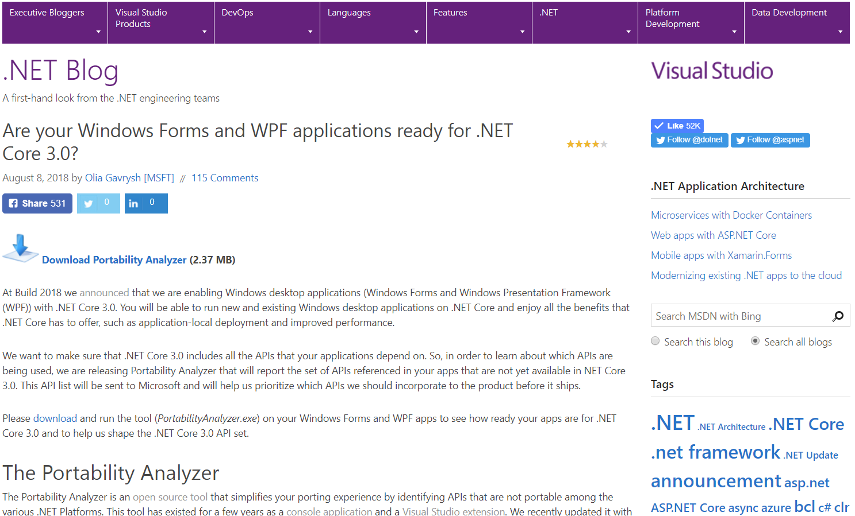
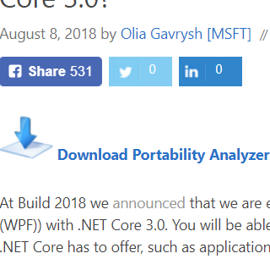
Is my application compatible with .NET Core 3?
Use Portability Analyzer
https://aka.ms/portabilityAnalyzer
.NET Blog: “Are your Windows Forms and WPF applications ready for .NET Core 3.0?”

Slide 31
Demo: Portability Analyzer
Notes:
Ask, if audience wants to see the demo, if not – save time for Q&A

Slide 32
Don’t forget to
Trivial things, yet worth mentioning:
Start with the project that doesn’t depend on other projects in your app
Consider updating NuGet references to the latest versions, especially if they are optimized for .NET Standard
Use source control ☺
Do one step at a time, build and run after each step

Slide 33
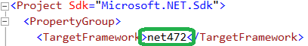
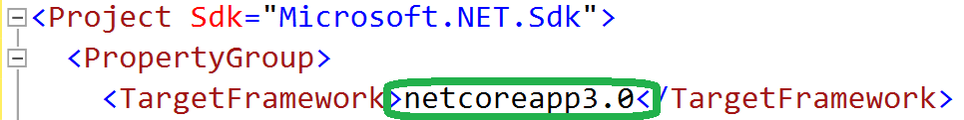
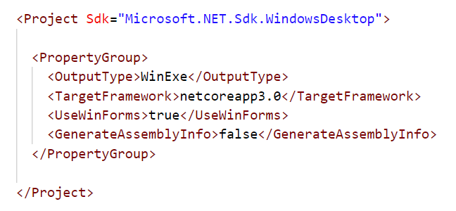
Porting
Porting to .NET Core\Standard is done by updating
If your .csproj file has old style, first migrate it to the new SDK-style

Slide 34
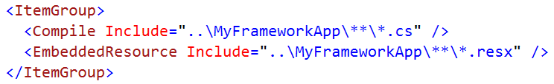
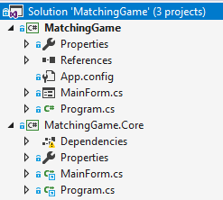
How to keep using full design tools – Option 1
Link existing .NET Framework sources into the new .NET Core app
Now you can use the designers in the old project while compiling it for .NET Core
.NET Core project links to files of .NET Framework project

Slide 35
How to keep using full design tools – Option 2
Have two project files: one targeting .NET Framework and another targeting .NET Core
Load your project with the Framework project file to work in WinForms designer

Slide 36
Windows Compatibility Pack
Provided as a NuGet Package
Microsoft.Windows.Compatibility
Can be referenced from .NET Core & .NET Standard
Has ~21k APIs (Windows-only as well as cross-platform)
Contents
ACLs
Code Pages
CodeDom
Configuration
Crypto
DirectoryServices
Drawing
EventLog
MEF
Odbc
Perf Counters
Permissions
Ports
Registry
Runtime Caching
WCF
Windows Services
…

Slide 37
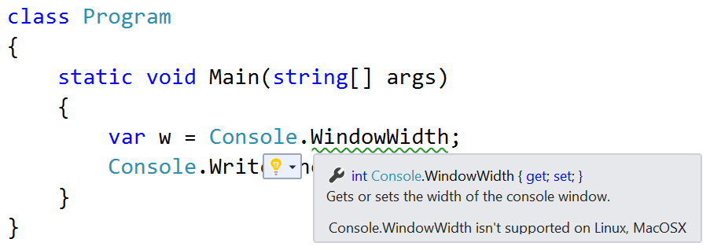
Detecting Platform Compatibility Issues
API Analyzer
https://aka.ms/apianalyzer
Roslyn analyzer that notifies you about the usages of APIs that don’t work across all platforms and about deprecated APIs
Great when building portable backend code for both client and server

Slide 38
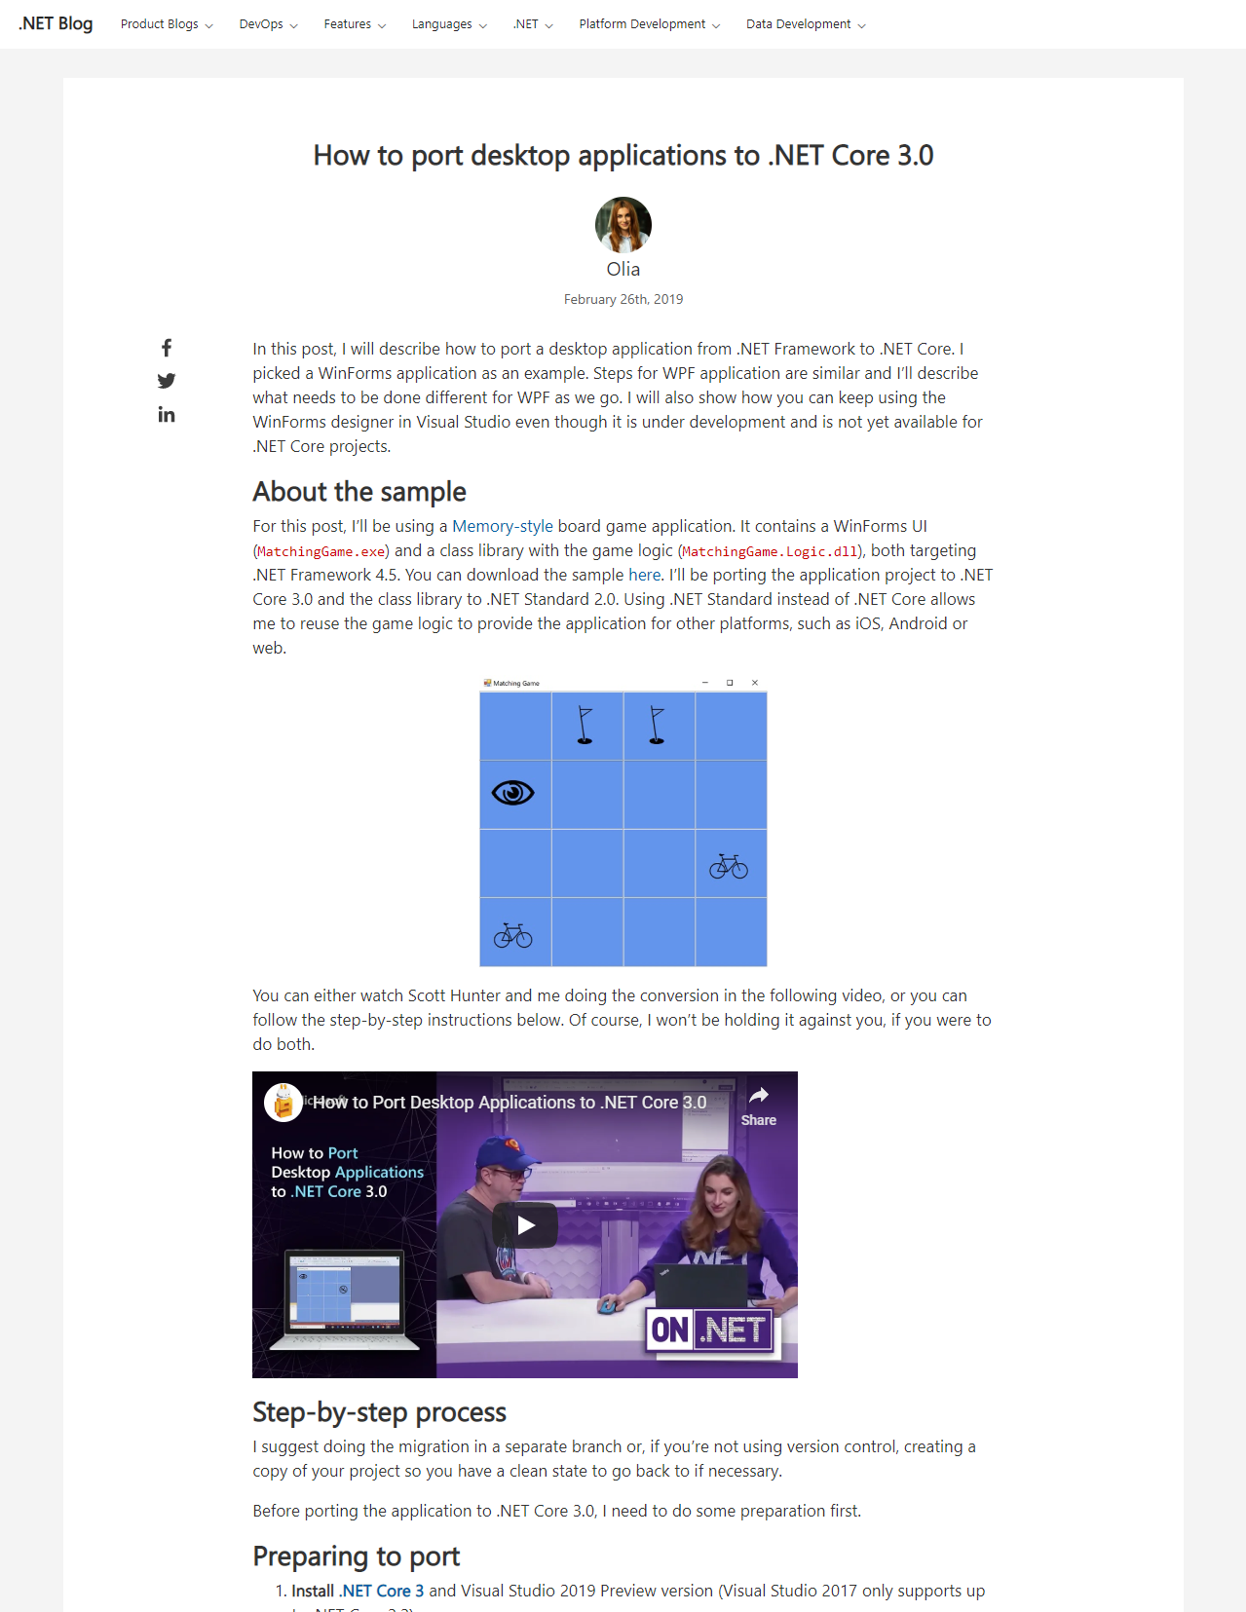
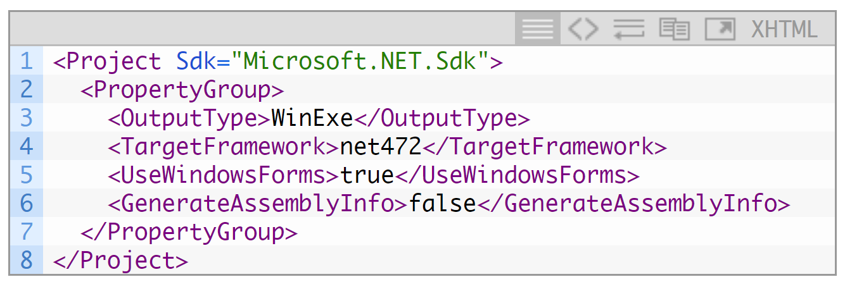
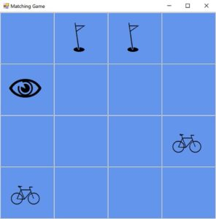
Step-by-step porting guide
.NET Blog
https://aka.ms/porting-to-netcore3

Slide 39
Roadmap

Slide 40
RELEASED
.NET Framework 4.8
Released on April 18th, available on Windows Update later in summer
Accessibility improvements in WinForms & WPF
Improved High DPI support for multi-monitor
JIT: parity with .NET Core 2.1 release
General security, performance, and reliability improvements
https://dotnet.microsoft.com/download/dotnet-framework/net48

Slide 41
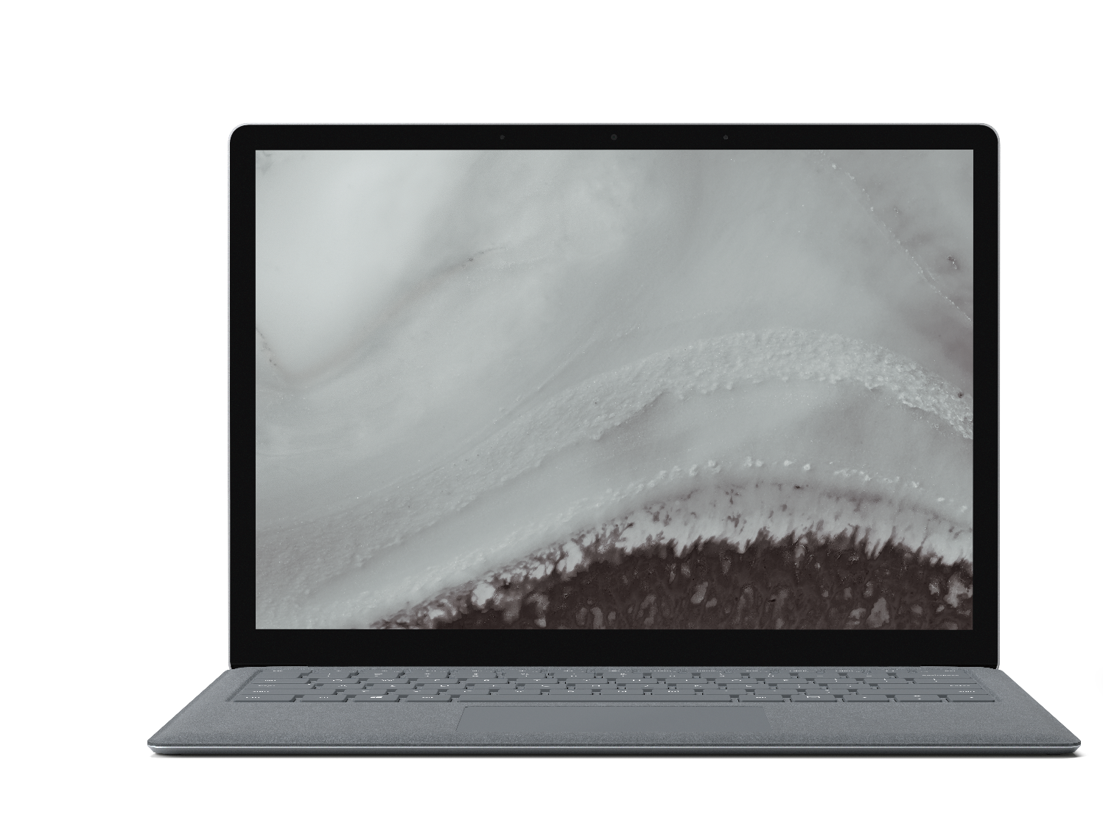
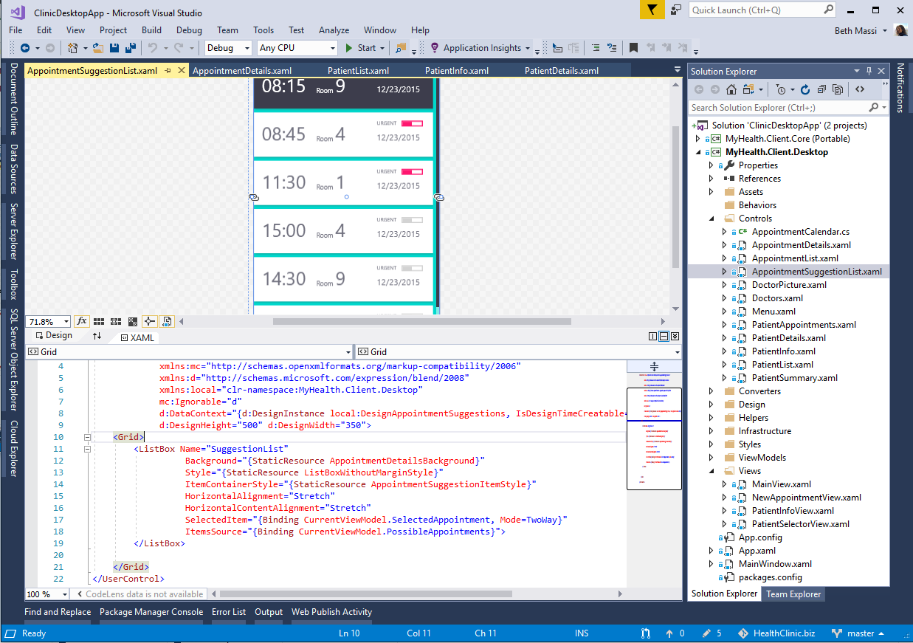
RELEASED
.NET Core 3.0 Preview 5
Windows desktop support with WPF and WinForms
Flexible deployment, side-by-side support and self-contained EXEs
Full-stack web development with C# and Razor
Significant performance improvements
New C# language features for productivity and less errors
https://dotnet.microsoft.com/download/dotnet-core/3.0
Notes:
We’re also announcing today the first preview of .NET Core 3. It comes with significant updates to desktop and server workloads.
.NET Core 3 brings Windows desktop development to .NET Core, with support for WinForms and WPF.
It enables more flexible deployment with side-by-side and self-contained EXEs.
We also have new features on the server side, including composable UIs with ASP.NET Core with Razor Components, which will provide full-stack web development with .NET for the first time.

Slide 42
.NET Schedule
July 2019
.NET Core 3.0
RC
Sept 2019
.NET Core 3.0
GA
Nov 2019
.NET Core 3.1
LTS
Nov 2020
.NET 5.0
GA
Nov 2021
.NET 6.0
LTS
Nov 2022
.NET 7.0
GA
Nov 2023
.NET 8.0
LTS
.NET Core 3.0 release in September
.NET Core 3.1 = Long Term Support (LTS)
.NET 5.0 release in November 2020
Major releases every year, LTS for even numbered releases
Predictable schedule, minor releases if needed

Slide 43
WinForms + WPF
Finish open-sourcing the code in the 3.0 timeframe
Bring the platforms to functional parity with .NET Framework
Complete and polish the tooling experience (e.g. design tools)

Slide 44
WinForms + WPF – What’s after GA?
Give us feedback!
File issues on GitHub:
https://github.com/dotnet/wpf
https://github.com/dotnet/winforms

Slide 45
Lab: Creating a new Windows Forms Application with .NET Core
Notes:
Ask, if audience wants to see the demo, if not – save time for Q&A

Slide 46
Lab: Creating a new WPF Application with .NET Core
Notes:
Ask, if audience wants to see the demo, if not – save time for Q&A

Slide 47
Lab: Porting to .NET Core
Notes:
Ask, if audience wants to see the demo, if not – save time for Q&A

